Slide 1
Effective Mobile App Development
November 27, 2018

Slide 2

Dylan Berry
15+ Years Professional Development experience
Mobile Developer @ BSI Labs
Xamarin Certified
4+ Years Mobile Development experience
Genetically predisposed programmer
https://about.me/dylanberry
👓

Slide 3
Background
Where are we now?

Slide 4
Tech in Canadian Biz
Conservative
Slow to adopt
Slow to change
Far behind
Fewer startups

Slide 5
At a Glance
IDI Ranking - Canada
2017 Rank | 29
2016 Rank | 25
2015 Rank | 23
2017 Value | 7.77
2016 Value | 7.62
2015 Value | 7.55
Notes:
IDI (Information and Communication Technology Development Index) Ranking
Canada is improving, but is being outpaced by the rest of the developed world.

Slide 6
Developer Landscape
Skills gap
Information overload
Focus on keeping the lights on
“Agile” tends to be abused
Demand for skills outstrips supply
Notes:
182k IT jobs unfilled by 2020

Slide 7
The Problem?
Notches…among other things…

Slide 8
Technology is hard
Business Problems
People Problems
Technology Problems

Slide 9
Mobile apps are VERY hard
Devices
Stores/Distribution
Testing
Feedback
Platform changes
Notes:
UX is REALLY important
Rapidly evolving hardware and software
Ongoing – different from the web
Lack of understanding
99 cent apps

Slide 10
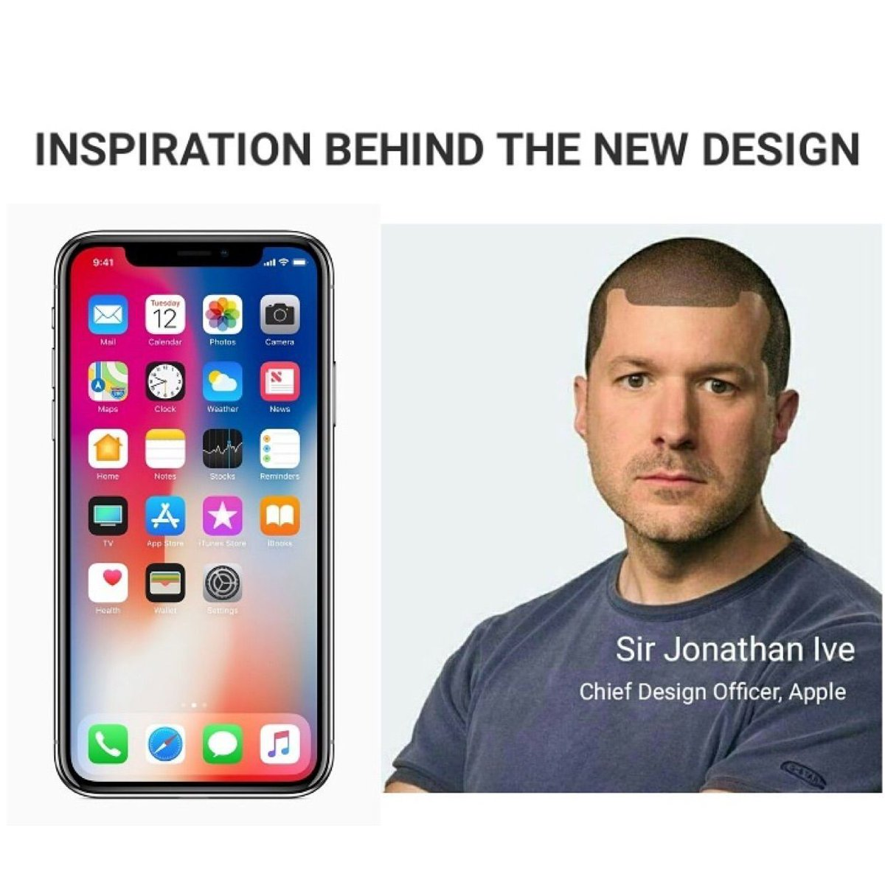
And it’s kind of strange…
Notes:
The notch is a pain in the ass.

Slide 11
Challenges
Tech giants slow to rollout to Canadian market
Ie. Cloud data centres within Canada
Regulatory concerns (privacy)
Technology changes fast
Notes:
Google announced data centre in May 2017
Azure Devops announced Sept. 22, 2017

Slide 12
More Challenges
What about web?
Technical constraints
Network availability/data limits
Device & platform capabilities
Battery usage
Versioning
Offline

Slide 13
Even More Challenges
Cost
Developer competency
Lack of stakeholder understanding

Slide 14


Slide 15
The Solution.
If you fail to plan, plan to fail.

Slide 16
Notes:
Jack Barker

Slide 17
Culture
Together
Everyone
Achieves
More
Notes:
Trust
Open communication
Continuous Improvement
Education
Planning
Winning as a team

Slide 19
Processes
Iterative
DevOps
User Feedback

Slide 20
Mobile Testing Process
Developer Testing
Unit Testing (Automated)
UI Testing (Automated)
Quality Assurance Testing
User Acceptance Testing
Beta Testing
Production Analytics & Feedback
Notes:
Development team tests against a variety of devices within a sprint
Unit tests are executed against each approved change to source code
UI tests are executed on a set of devices
QA team tests against a variety of devices to validate acceptance criteria
A small group of UAT testers receives the app and is engaged for feedback
A larger beta audience receive the app and are engaged for feedback
Production analytics and feedback is continuously monitored

Slide 21
Notes:
”If you’re not embarrassed by v1, you’re doing it wrong”
Public Beta (App Store Connect + Google Play)

Slide 22

Notes:
Average business app costs ~$250,000 to build¹
Less than 6% of apps are VC funded²
Most apps are funded out of pocket by companies and individuals²
https://blog.formotus.com/enterprise-mobility/figuring-the-costs-of-custom-mobile-business-app-development
https://www.ictc-ctic.ca/wp-content/uploads/2014/02/AppificationFeb2014.pdf

Slide 23
Influence
Notes:
Sell the vision!
Get key stakeholders involved early

Slide 24
The Tools
Let’s see some %$#@ code already.
Notes:
Mac
Parallels
Visual Studio + R#
VS for Mac + Mfractor + LiveXAML
Rider
Android Studio/Android SDK
Xcode
Azure DevOps
App Center
Azure

Slide 25
Demo: Xamarin Forms

Slide 26
Demo 2: Flutter
Notes:
https://developers.google.com/events/flutter-live/ Flutter Live, Dec 4th

Slide 27
Demo 3: Serverless
Protect Ya Neck

Slide 28
Demo 4: DevOps
Azure DevOps, App Center and the stores

Slide 29
Wrap it Up!
Conclusion, resources and thank you.

Slide 30
Know Thyself
Understand your needs
Native App? Hybrid App? PWA? Mobile friendly site?
Know when to ask for help
Community
Training
Consultants

Slide 31
Communicate
Talk to target users
Work with stakeholders and executives
Notes:
Remember: Agile manifesto values Customer collaboration

Slide 32
Resources
https://flutter.io/
https://docs.microsoft.com/en-us/xamarin/cross-platform/get-started/
https://www.jetbrains.com/rider/
https://visualstudio.microsoft.com/vs/mac/
https://www.mfractor.com/
https://www.livexaml.com/
https://github.com/TorontoMobileDevelopers

Slide 33
References
Mobile App Spectrum
https://dev.to/kayis/the-mobile-app-spectrum
How Long To Build An App
https://www.kinvey.com/how-long-to-build-an-app-infographic/
Costs of Custom Mobile Business App Development
https://blog.formotus.com/enterprise-mobility/figuring-the-costs-of-custom-mobile-business-app-development
How Do I Fund My Startup
https://www.marsdd.com/mars-library/funding-startup/
Co-creation Designing with the User for the User
http://www.uxbooth.com/articles/co-creation-designing-with-the-user-for-the-user/

Slide 34
Thank You!

